Slide 1


Microservices
Lessons from the Trenches

Slide 2
Agenda
Introduction
Preparing for Invasion
Boot Camp
Into the Trenches
Debriefing

Slide 3
Introduction
Introduction
Preparing for Invasion
Boot Camp
Into the Trenches
Debriefing

Slide 4

When & Where?
Location: Swang 246
Date: August 20
Time: 13:00 – 14:00

Slide 5
Who?
Architect
Integration
Film Major
Web Services
Graphic Artist
Foundations
1993
1997
2000
2002
2005
2010
2014
Al Gore
Invents
Internet
Developer (full time)
XML (early services)
SOA/
Integration
Architect (full time)
Enterprise
Architect
Micro- Services

Slide 6
What?
Foundations
Integration
How do you organize code?
How do you deploy software?
How do you build software?
Microservices are integration technology
Web Services
Architect
Microservices are deployed to connect systems/applications through networks
Boundaries
Contracts
Microservices are an architectural style
Business and IT
Constraints

Slide 7
What?
Products, Not Projects
Componitization
via Services
Adapted from Martin Fowler’s article: “Characteristics of a Microservice”- http://goo.gl/AZwucZ
Organized around
Business Capability
Decentralized
Data

Slide 8








What?
Decentralized Governance
Adapted from Martin Fowler’s article: “Characteristics of a Microservice”- http://goo.gl/AZwucZ
Infrastructure
Automation

Slide 9
What?
Smart Endpoints,
Dumb Pipes
Adapted from Martin Fowler’s article: “Characteristics of a Microservice”- http://goo.gl/AZwucZ
Evolutionary Design

Slide 10
What?
Architectural Style
microservice architectural style
microservice architectural style
In short, the microservice architectural style is an approach to developing a single application as a suite of small services, each running in its own process and communicating with lightweight mechanisms, often an HTTP resource API
Adapted from Martin Fowler’s article: “Characteristics of a Microservice”- http://goo.gl/AZwucZ

Slide 11
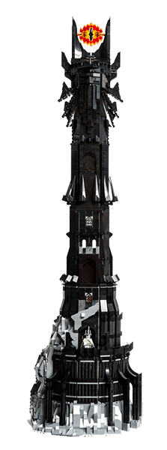
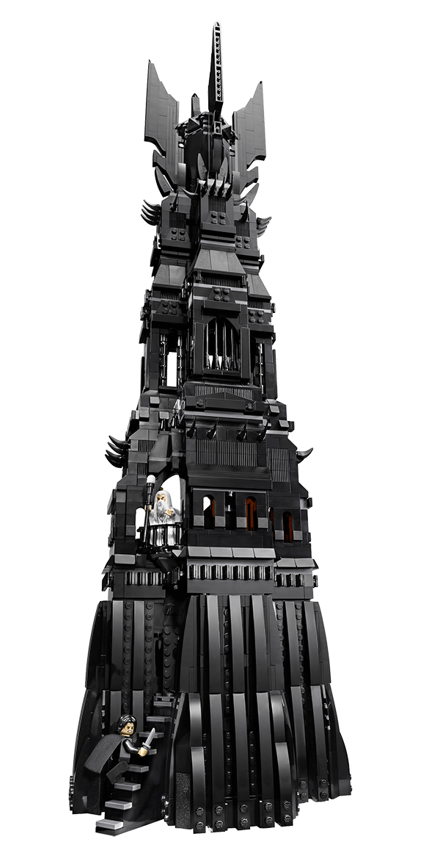
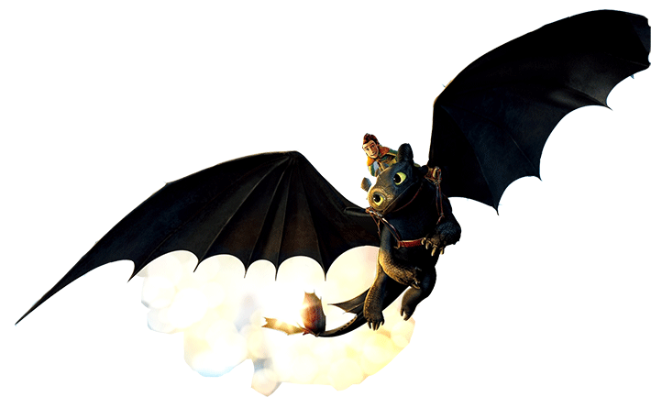
How?
Memory Aids
Analogies
Real World Problems

Slide 12
Boot Camp
Introduction
Preparing for Invasion
Boot Camp
Into the Trenches
Debriefing

Slide 13
Boot Camp
The Two Towers
The Wizard of Oz
How to Train Your Dragon
Back to the Future

Slide 14
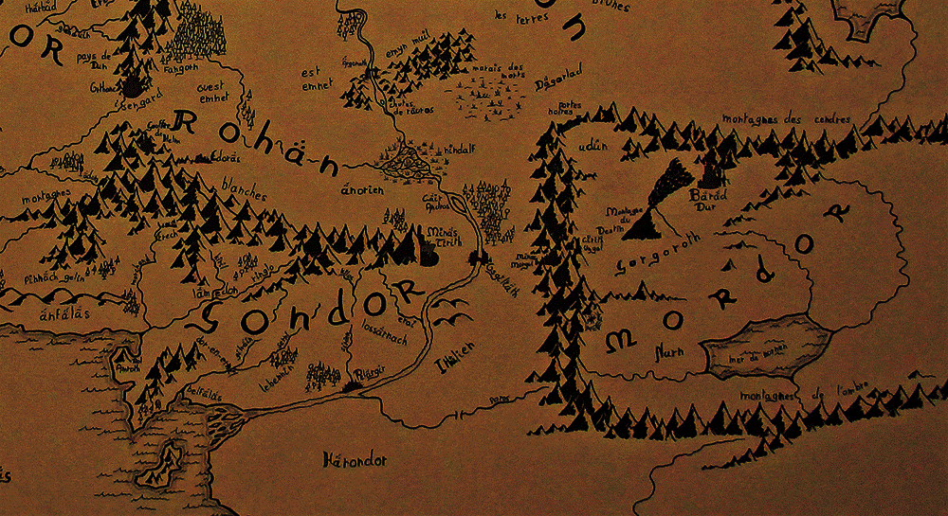
Foundations
CEO
CIO
COO
CTO
VP
The Two Towers
Enterprise Architect
Director
Solution Architect
Manager
Application Architect
Project Manager
Senior Developer
Junior Developer
Business
Analyst

Slide 15

Foundations
Software is a Bunch of BS
State
The Two Towers
Customer
Order
Name
Billing
Address
Security Info
Shipping
User Id
Password
Behavior

Slide 16
Foundations
Preliminary
Architecture
The Two Towers
A
Entities
H
Architecture
Vision
Business
B
Architectural Change Management
Business Architecture
Workflow
D
C
Data
Development
Implementation Governance
Requirements Management
Information Systems Architecture
Applications
IT Architecture
F
D
Migration
Planning
Technology Architecture
E
Opportunities & Solutions
Infrastructure

Slide 17
Foundations
Vision: WHY are we building?
The Two Towers
A
H
Architecture
Vision
B
Back to
Business
Implementation & Governance: WHERE are we?
Are we building it right?
Architectural Change Management
Business Architecture
D
C
Architecture:
WHAT are we building?
Implementation Governance
Requirements Management
Information Systems Architecture
F
Constraint
D
Issue
Migration
Planning
Technology Architecture
Planning: HOW are we building?
WHAT are we building WHEN?
E
Opportunities & Solutions

Slide 18
Foundations
Business Drives IT
Software is BS
State
Changes during activities
Persistence between activities
Behavior
Represented as Workflow
Focuses primarily on changing state
Extras
Learn business to really succeed in Information Technology
The Two Towers

Slide 19
Foundations
Applicable Points for Microservices
Focus on Business Capabilities
The Two Towers

Slide 20
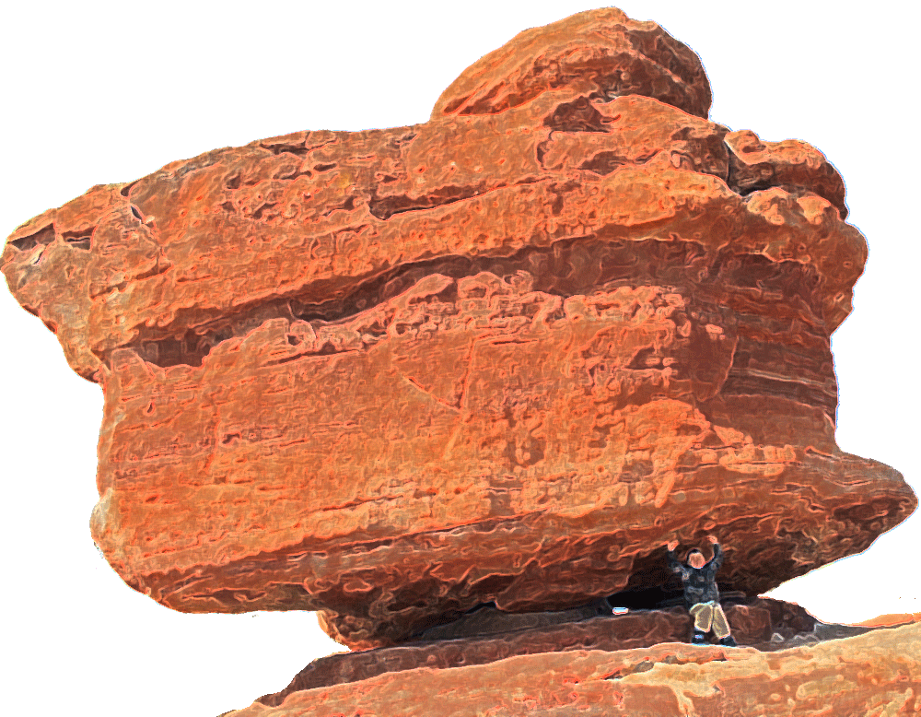
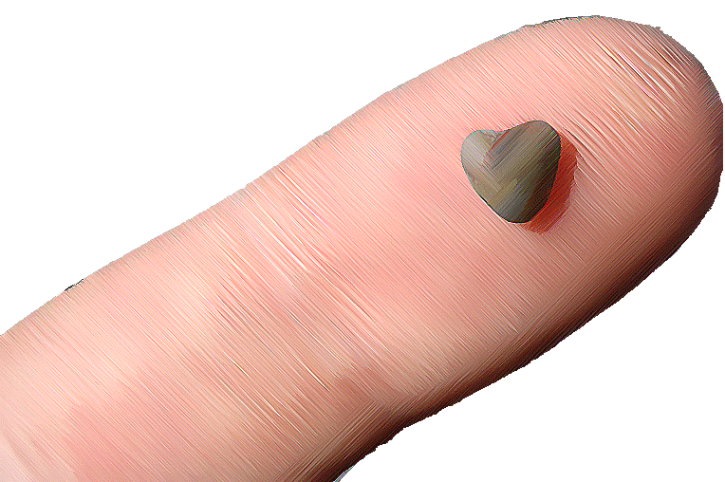
Boot Camp
The Wizard of Oz

Slide 21
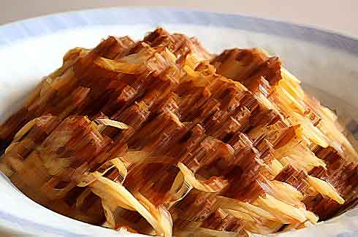



Boot Camp
The Wizard of Oz

Slide 22
Foundations
The Wizard of Oz
Complex
Difference
Complex
Simple

Slide 23
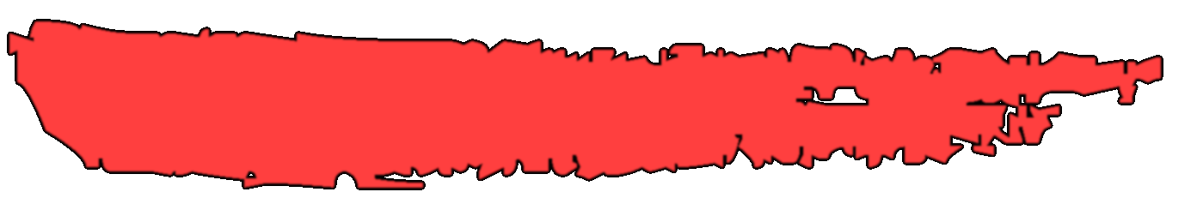

Complexity
“Energy cannot be created or destroyed, it can only be changed from one form to another.” - Albert Einstein

Slide 24

“Complexity cannot be destroyed, it can only be changed from one form to another.” - Gregory Beamer

Slide 25
Foundations
UI
The Wizard of Oz
Service
Business
Data

Slide 26
Foundations
The Wizard of Oz

Slide 27
Foundations
Applicable Points for Microservices
Microservices are not some new, revolutionary idea
Microservices are not Simple; they are just another form of complex
Wizard of Oz

Slide 28

Boot Camp
User Name
Password
How to Train Your Mother-in-Law
Dragon
Access Token
Contracts
Access Token
List of Orders

Slide 29
Boot Camp
System 1
System 2
Message Based
Real Time
How to Train Your Mother-in-Law
Dragon
System 1
System 2
ESB
Batches
Publisher/Subscriber
Many Systems with same data
System 3
Message Queue
Integration Hub

Slide 30
Foundations
Applicable Points for Microservices
Microservices are an integration technology, therefore …
Microservices deal with boundaries
Focusing on contracts up front will reduce issues during development
Wizard of Oz

Slide 31
Boot Camp
CASA Development Model
Core AS Application
Test Driven/
Test Early Approach
TDD
BDD
Back to the Future
ATDD
Adapter-based
Boundaries
TESTS
ADAPTER
ADAPTER
CORE
CONTRACT
CONTRACT
ADAPTER
ADAPTER
Mi casa es
Su casa!
Contract First Development
DOMAIN
Domain Driven Design

Slide 32
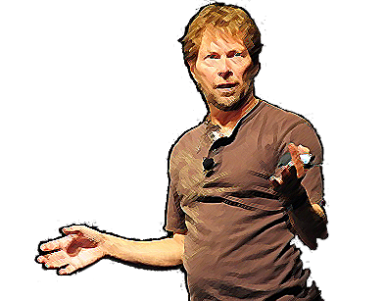
Boot Camp
Back to the Future
Alistaire Cockburn
Hexagonal
Architecture

Slide 33
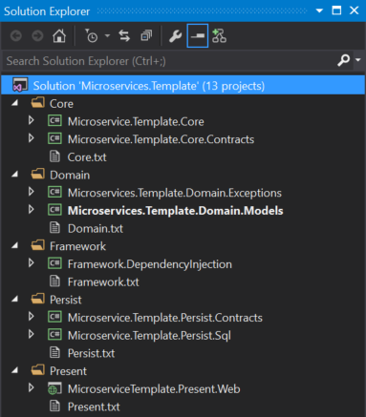
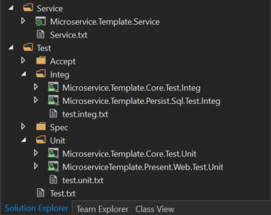
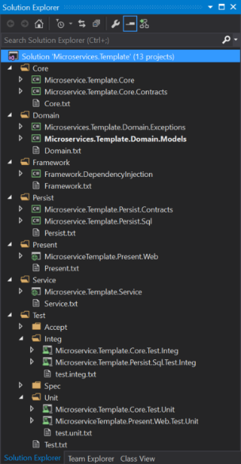
Tests
Contract
CORE
Contract
Adapter
Domain Models

Slide 34
Foundations
Applicable Points for Microservices
Don’t reinvent the wheel each time – Focus on the core
Separating concerns opens the door for the future
Back to the Future

Slide 35
Boot Camp
The Two Towers
The Wizard of Oz
How to Train Your Dragon
Back to the Future
Focus on business capabilities
Microservices are complex
Microservices live on boundaries
Focus on contracts first
Focus on the core to future proof your investements

Slide 36
Preparing for Invasion
Introduction
Preparing for Invasion
Boot Camp
Into the Trenches
Debriefing

Slide 37
Preparing for Invasion
Inception
The Big Short
The Hobbit
Office Space
The Avengers

Slide 38
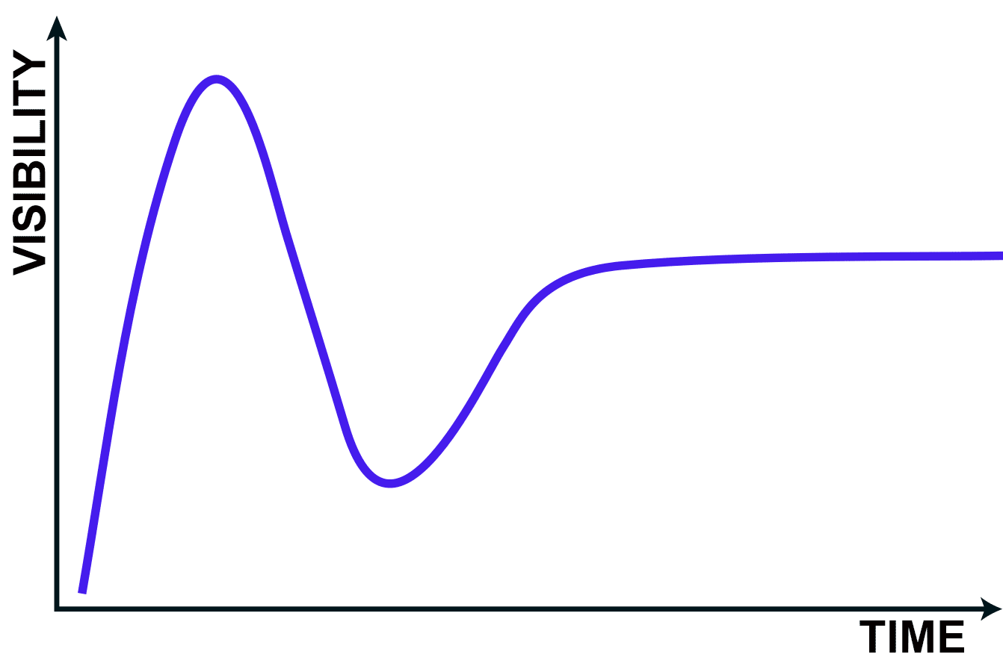
Preparing for Invasion
Peak of Inflated Expectations
The Big Short
Microservices
Plateau of Productivity
Big Data
Virtualization
PaaS
Personalization
SaaS
Slope of Enlightenment
Trough of Disillusionment
Technology Trigger

Slide 39
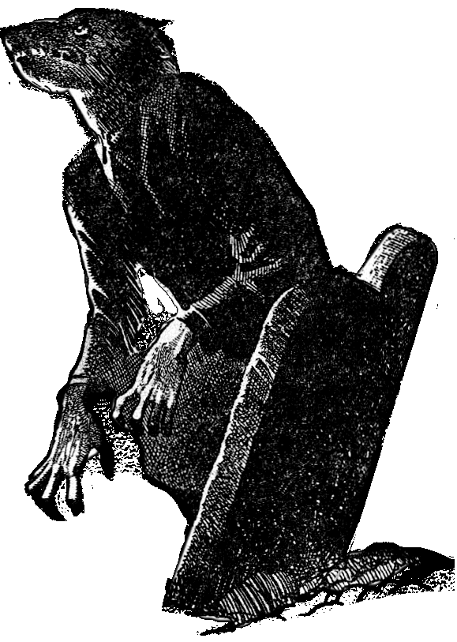

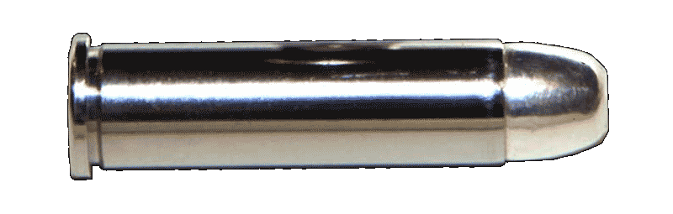
Preparing for Invasion
Silver Bullets Kill Werewolves
The Big Short

Slide 40
Preparing for Invasion
The Hobbit
UI
From Cesar de la Torre’s article – Azure Fabric and the Microservices Architecture – http//:goo.gl/i4tTiM

Slide 41
Preparing for Invasion
The Hobbit
UI
UI
Service
Business
Data

Slide 42
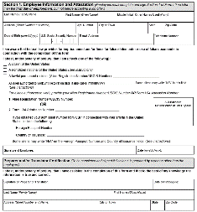
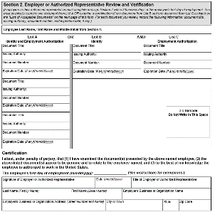
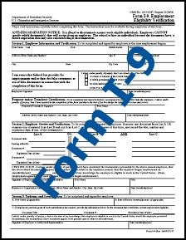
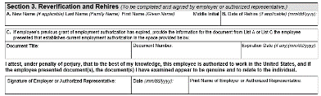
Preparing for Invasion
Eligibility
The Hobbit
Certification
Rehire

Slide 43
Preparing for Invasion
Security
The Hobbit
Scheduling
Shopping Cart
User

Slide 44
Preparing for Invasion
Decompose based on business capability
Can I commoditize the functionality?
Can I segregate out the capability?
Further decompose where possible
Don’t decompose based on data structures
The Hobbit

Slide 45
Preparing for Invasion
Inception

Slide 46
Preparing for Invasion
UI
Outer Complexity
Inception
Inner Complexity
Service
Business
Data

Slide 47
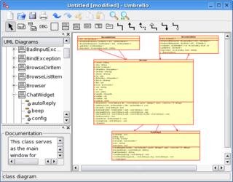
Preparing for Invasion
“CASE” Tools
“Computer Aided
Software Engineering”
Inception
Inner Complexity
Best Practices
Focus on producing quality code faster

Slide 48
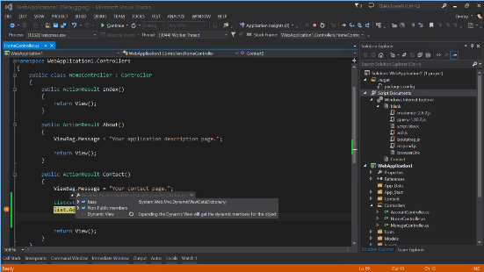
Preparing for Invasion
Inception
UI
Inner Complexity
with
Outer Complexity
Focus Shift from code generation to ….
Frameworks
Boilerplates
Patterns
Code Optimization Tools
Service
Business
Data
Focus on the business problem

Slide 49
Preparing for Invasion
Evolutionary Design
Agile Practices
Automation
Dev Ops
Commoditization
API Management
Inception
Outer Complexity
Focus on the software delivery
And reducing risk by bringing in
experts

Slide 50
Preparing for Invasion
Inner Complexity - Monolith
Best Practices
CASE Tools
Mixture – Layered/SOA
Development IDEs
Templates and Frameworks
Outer Complexity
Commoditization
DevOps, Agility
API Management
Inception

Slide 51






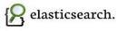






Preparing for Invasion
DevOps
Reqs/Design
Development
Deployment/Testing
Support
The Avengers
Portfolio, Product & Requirements Management
Support Enablement
Continuous Quality
APM/UIM
Continuous Inspection
Analytics/Search
Version Control
Continuous Integration/
Delivery
Environments
Changeman
ZMF
Code Review
Test Data Management
Configuration Management
Build Automation
Infrastructure Automation
Copy Data Management
UST Global Edge OpsTM

Slide 52
Preparing for Invasion
Source Control
Continuous Integration
Build Management
Release Management
Infrastructure Automation
In Windows Server 2016 - Containers
The Avengers

Slide 53
Preparing for Invasion
Office Space

Slide 54





Preparing for Invasion
API Management
API Gateway
Office Space
Discoverability
Developer Help
Management
Analytics
Metrics
Proxy

Slide 55



Preparing for Invasion
Monitoring
Office Space

Slide 56
Into the Trenches
Choreography and Orchestration

Slide 57
Into the Trenches
Office Space

Slide 58
Into the Trenches
Office Space
Orchestration
Choreography

Slide 59
Into the Trenches
Office Space
Patterns
Circuit Breaker
Bulkhead
Monitoring
API Management

Slide 60
Into the Trenches
Office Space
Bulkheads
Circuit Breakers

Slide 61
Into the Trenches
Office Space
Monitoring
ALERT

Slide 62
Into the Trenches
Office Space
API Management
ALERT

Slide 63
Preparing for Invasion
Inception
The Big Short
The Hobbit
Office Space
The Avengers
Don’t get caught up in the hype
Decompose on business capabilities
Commoditize complexity
Automation saves
Manage failure

Slide 64
Into the Trenches
Introduction
Preparing for Invasion
Boot Camp
Into the Trenches
Debriefing

Slide 65
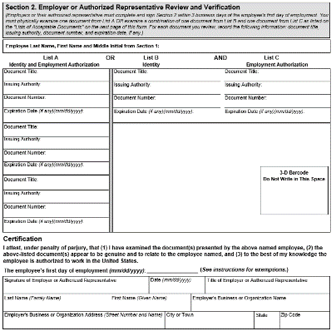
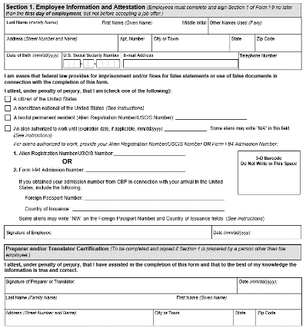
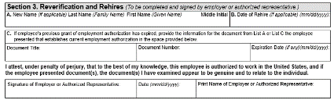
Into the Trenches
Business Capabilities

Slide 66
Into the Trenches
Business Capabilities
1
i-9 Application
2
3

Slide 67
Into the Trenches
Business Capabilities
1
i-9 Application
2
3

Slide 68
Into the Trenches
Business Capabilities
Section 1
Employee
W2 Application
i-9 Application
Section 2
Align to Business Capabilities
Immigration
Section 3
Signature
Overly Decomposed

Slide 69
Into the Trenches
Business Capabilities
Commodities
Easily Segregated
Owned by a Different Group
Business Capabilities

Slide 70
Into the Trenches
UI
Segue
From Cesar de la Torre’s article – Azure Fabric and the Microservices Architecture – http//:goo.gl/i4tTiM

Slide 71
Into the Trenches
Legacy Modernization through Microservices

Slide 72
Into the Trenches
CURRENT
MODERNIZED
Prepped for Strangulation
Legacy Modernization through Microservices
Adapted from Martin Fowler’s article: “Strangler Application”
http://goo.gl/1tXGNB
End State
Side by Side
New development on modern platform

Slide 73
Into the Trenches
1
Identify Business Rules
Legacy Modernization through Microservices
2
Identify Code to Segregate

Slide 74
Into the Trenches
Legacy Modernization through Microservices

Slide 75
Into the Trenches
Legacy Modernization through Microservices
1
Modernized Services
2
Connectivity to Legacy

Slide 76
Into the Trenches
Legacy Modernization through Microservices
1
New Development in Modern Environment
2
Service Integration with various applications

Slide 77
Into the Trenches
Other Configurations

Slide 78
Into the Trenches
Other Configurations
CRUD

Slide 79
Debriefing
Introduction
Preparing for Invasion
Boot Camp
Into the Trenches
Debriefing

Slide 80
Boot Camp
Business Leads IT
Focus on business capabilities
Microservices are complex
We need to handle complexity
Microservices live on boundaries
Need to determine contracts early
Focus on the business core

Slide 81
Preparing for Invasion
Too Much Hype
Silver Bullets Kill Werewolves
Decompose on Business Capabilities
Commoditize Complexity
Invest in Solutions that Reduce Complexity
Automation Saves
Adopt a DevOps Culture
Manage Failure
Include Patterns for Failure
Monitor for Failure
Prepare to Handle Failure

Slide 82
Into the Trenches
Examples
Business Capabilities
Legacy Modernization through Microservices
Inability to Segregate Data
Business Capabilities

Slide 83
Q&A
Microservices
http://goo.gl/AZwucZ
Strangler Application
http://goo.gl/1tXGNB
Microservices in Azure
https://goo.gl/i4tTiM

